Slide 1

Introduction To Internet Application Presentation
Presented by Group 27

Slide 2
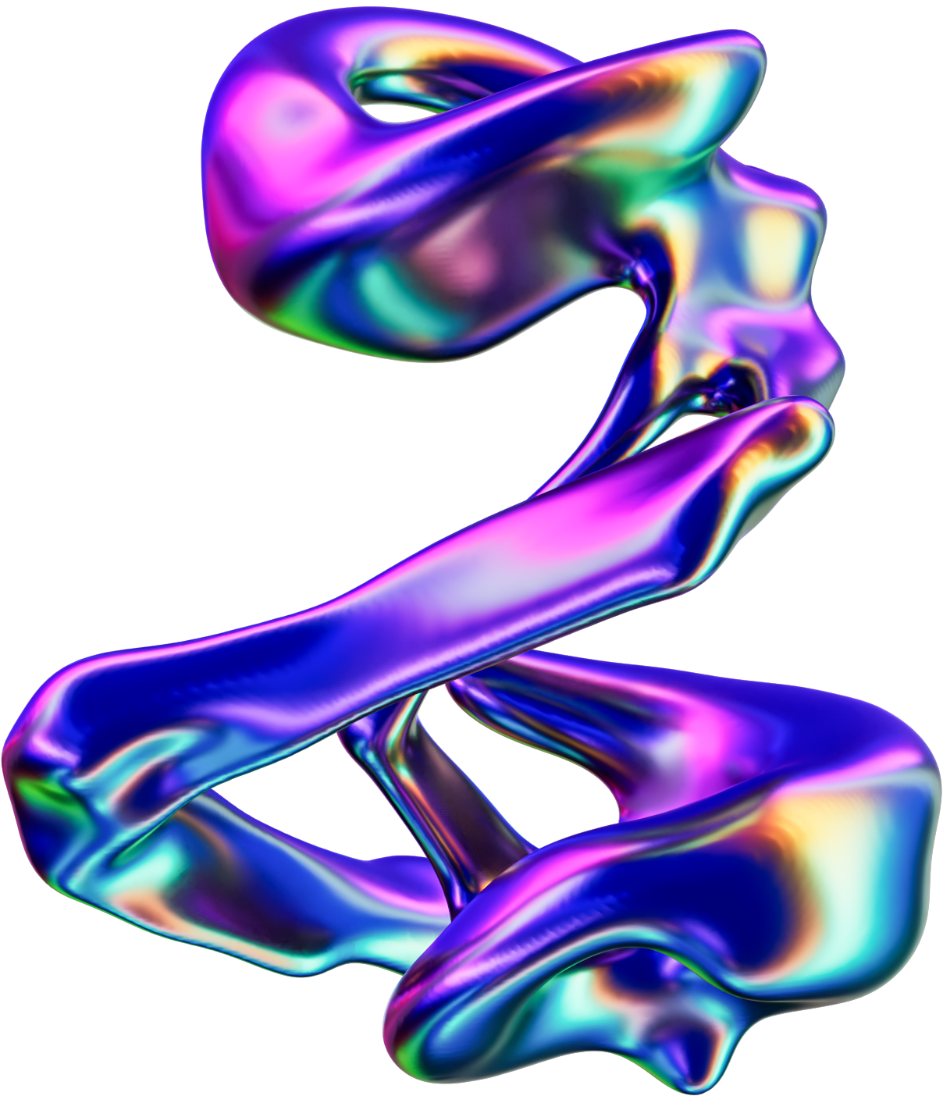

Members:
Joshua Paul (Leader)
Albin Gurung
Yunchho Limbu
Rohan Roka
Mohamed Maheen
Lok Kai Chun

Slide 3
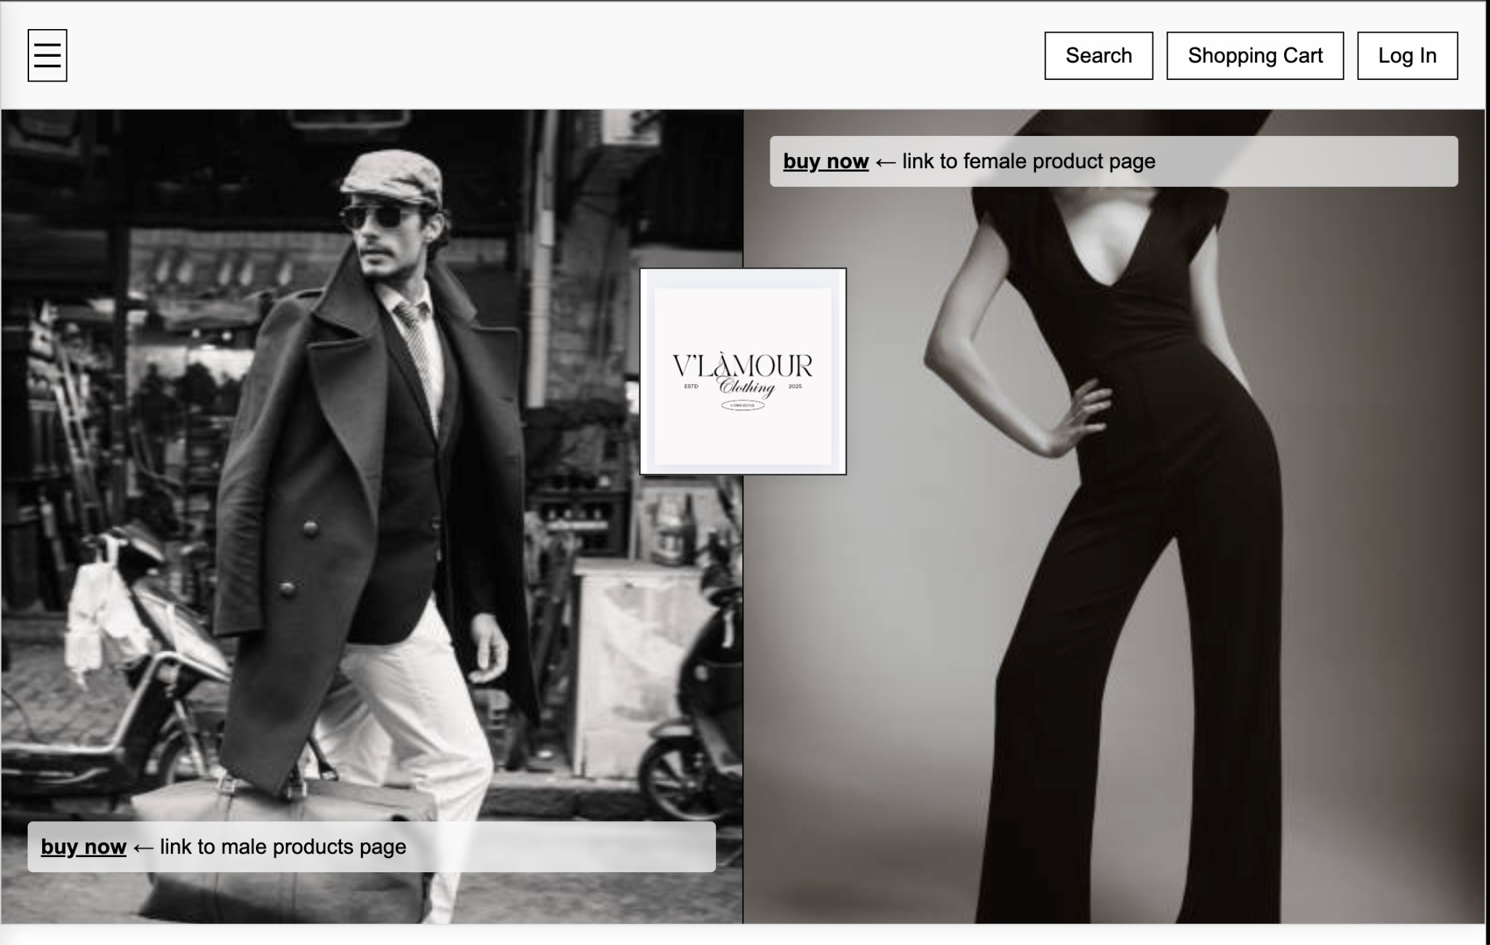
Main Page
Used HTML,CSS and Javacript to build our Website
Consists different functions like search options,Shopping Cart, Log in page.

Slide 4
Main Page

Slide 5
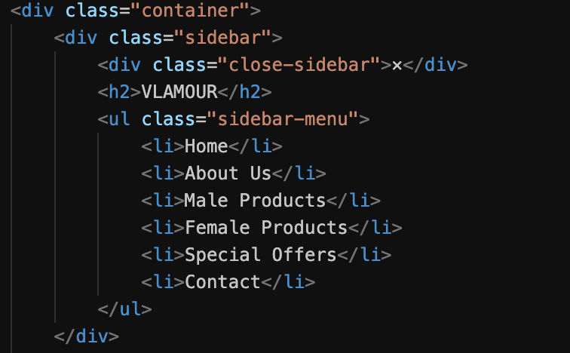
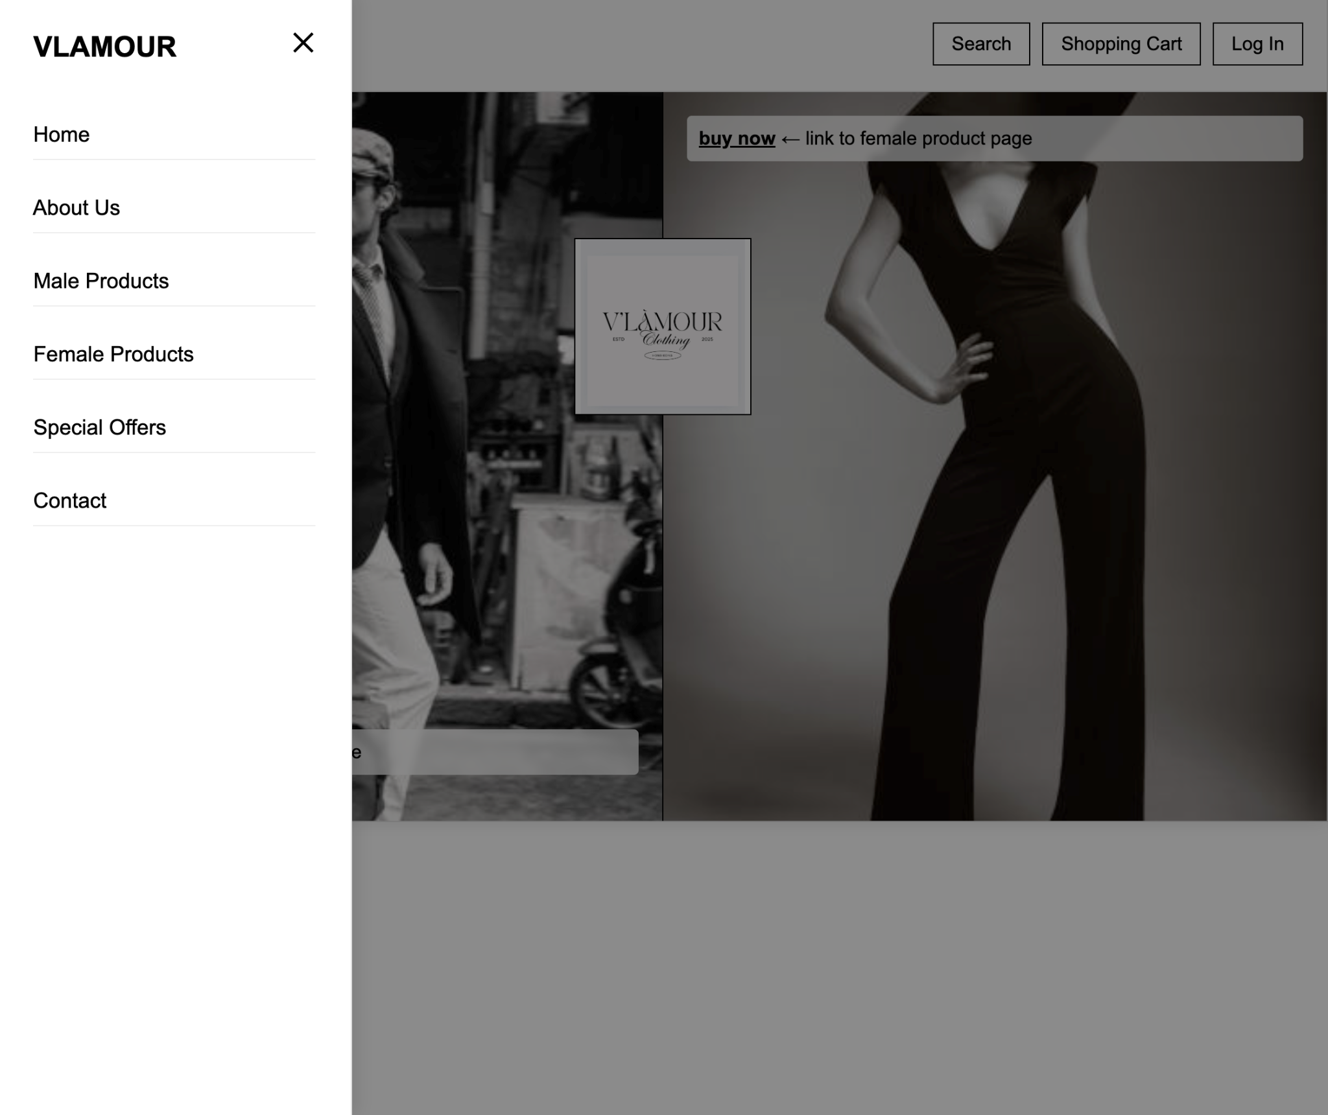
Sidebar Design
<div class="container">: A main container to hold all the website's content.
<div class="sidebar">: Creates a sidebar navigation menu.
Created an unordered list for the sidebar menu items.

Slide 6
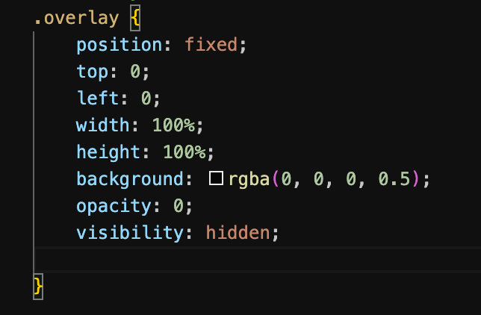
Sidebar Design
(0, 0, 0) means no red, no green, and no blue, which makes it black.
0.5 is the alpha value, meaning the black background is semi-transparent (50% see-through).

Slide 7
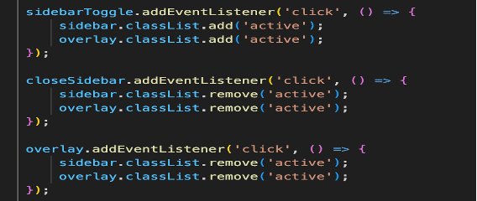
Sidebar Design
Functionality of JavaScript
addEventListener('click', ...) allows to detect clicks on the menu button.
classList.add('active') to make the sidebar and overlay visible.
Clicking the close button or the overlay removes these classes using classList.remove('active'), which hides the sidebar."

Slide 8
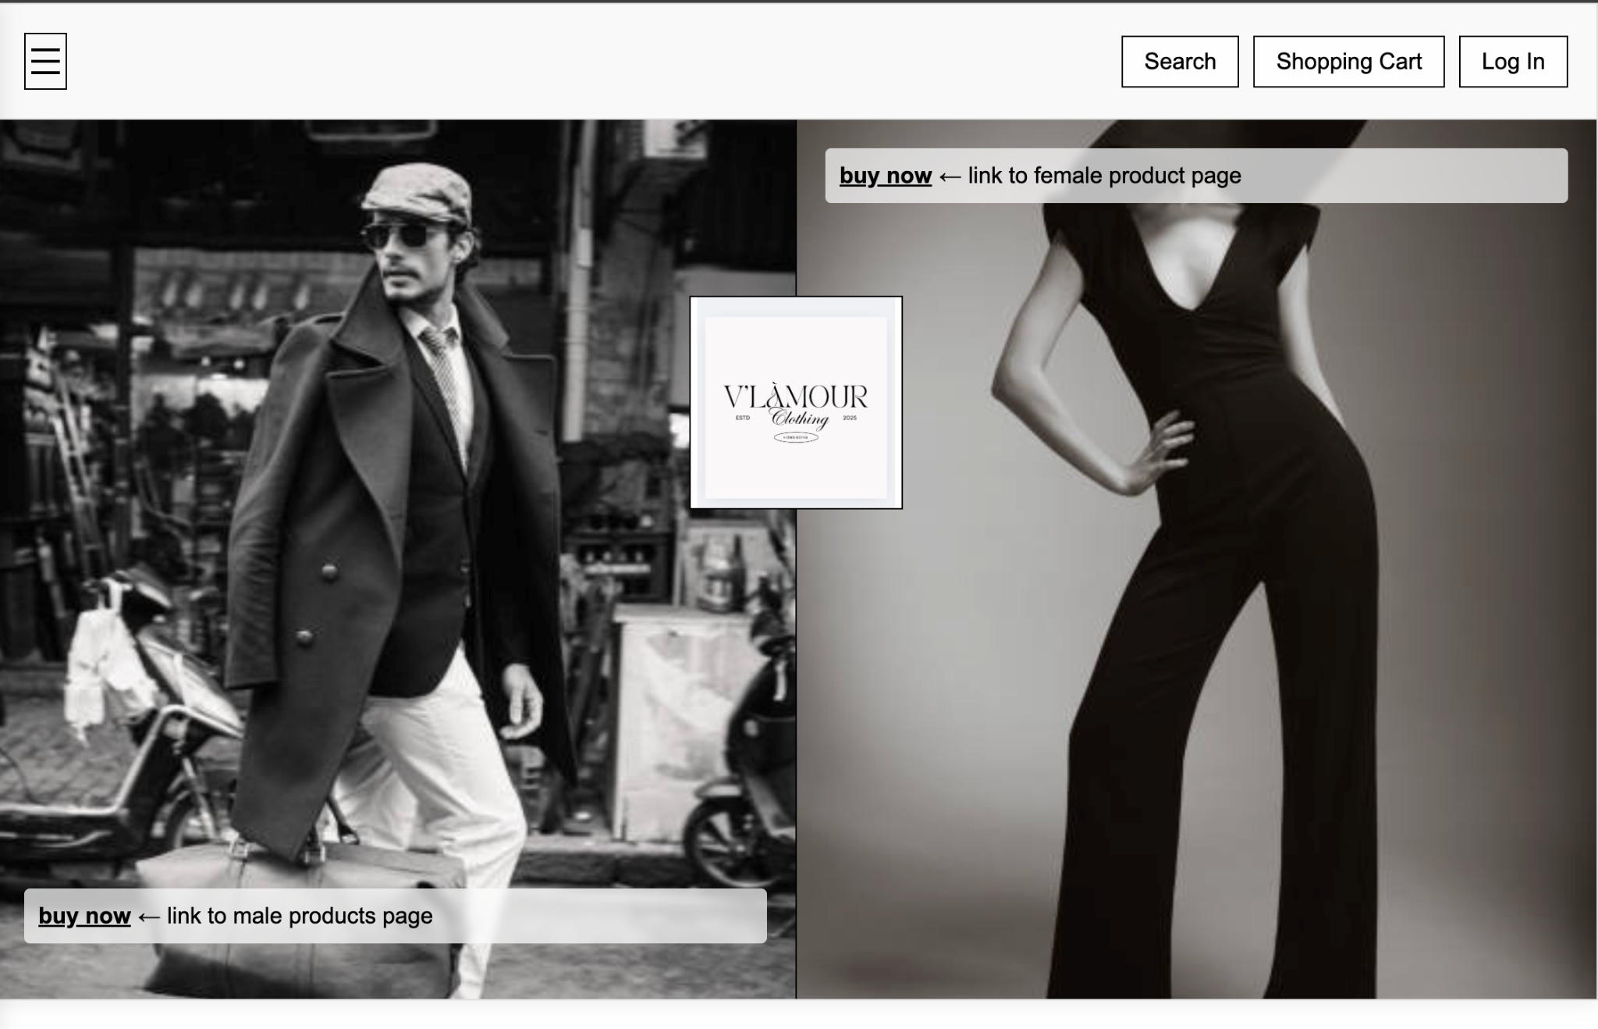
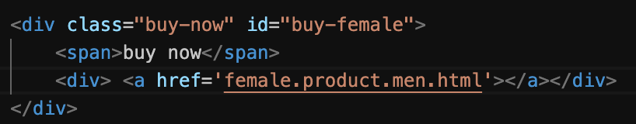
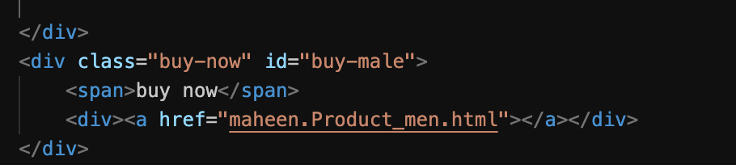
Main section of Mainpage
Female’s Section
Men’s Section

Slide 9
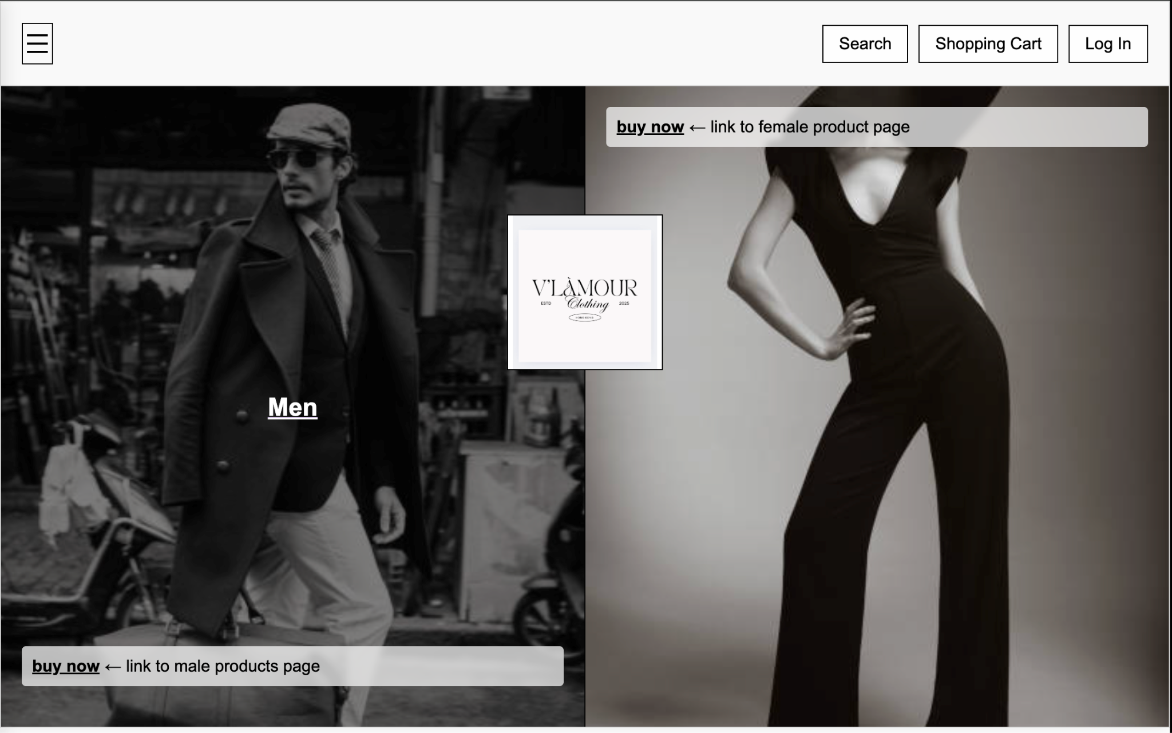
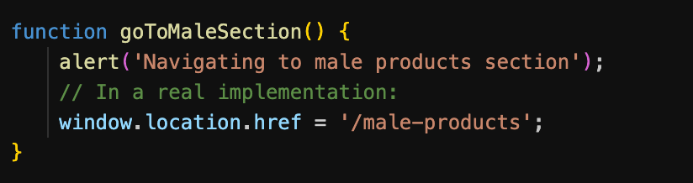
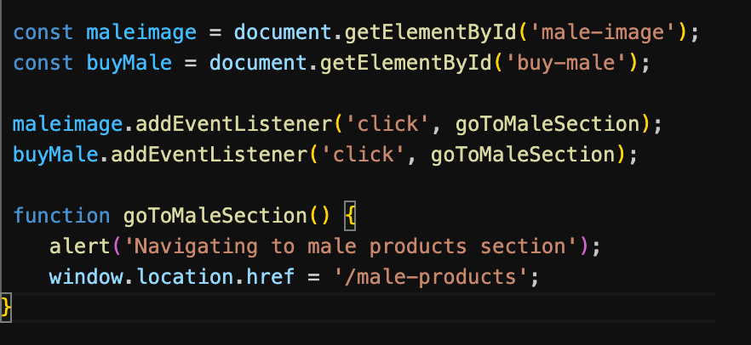
It listens for a click.
goToMaleSection function is triggered when we click male image or buyMale
The function shows an alert and would navigate to the male products sections

Slide 10
MAIN PAGE

Slide 11
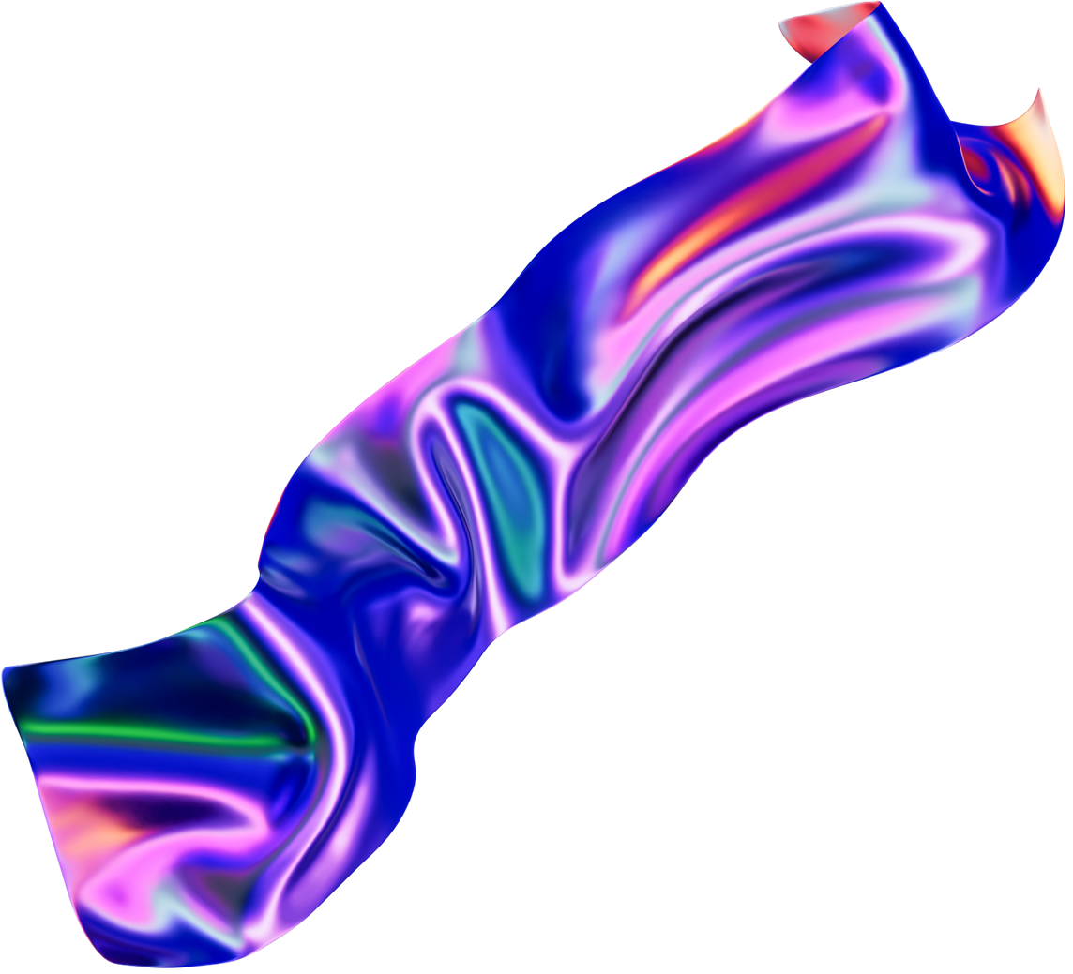
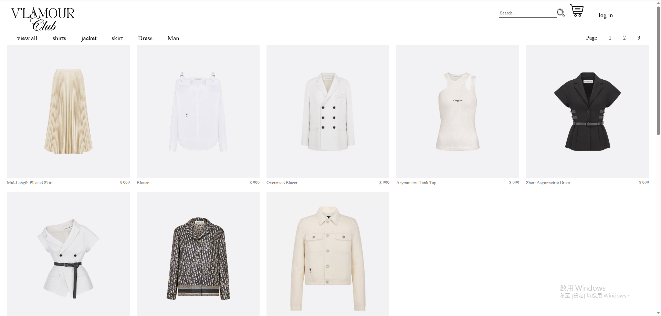

Slide 12
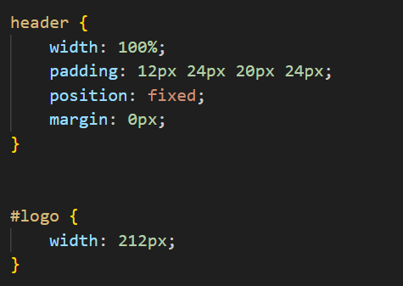
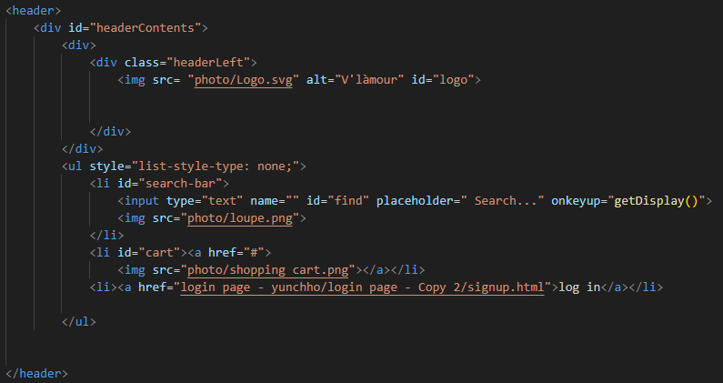
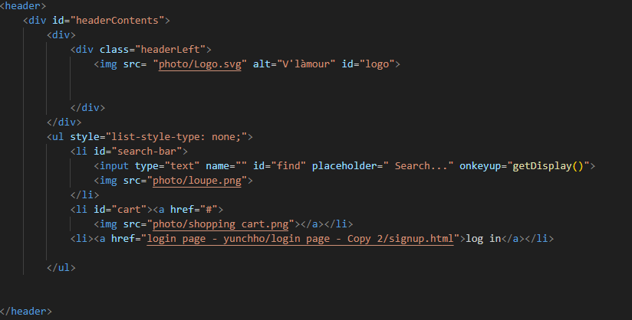
Header Design
CSS

Slide 13
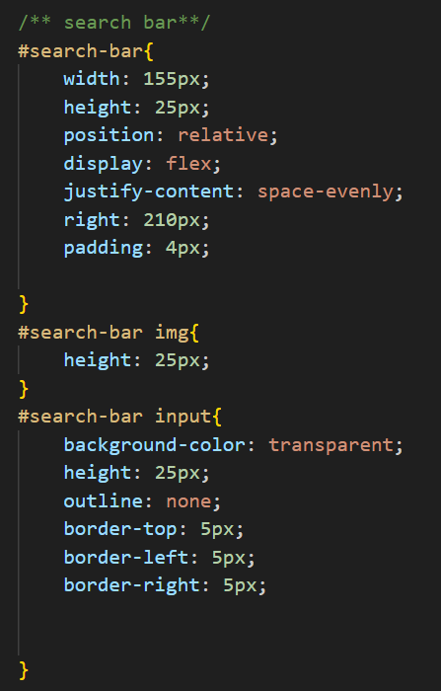
Header Design

Slide 14
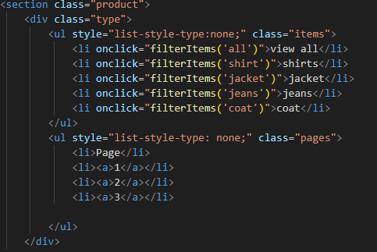
Header Design

Slide 15
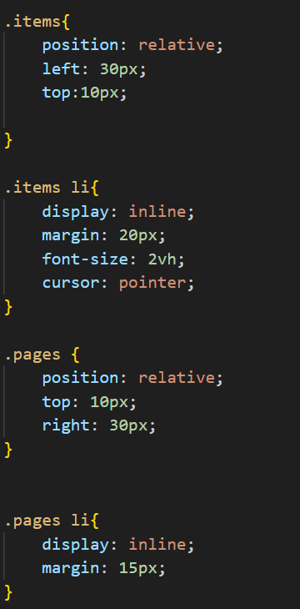
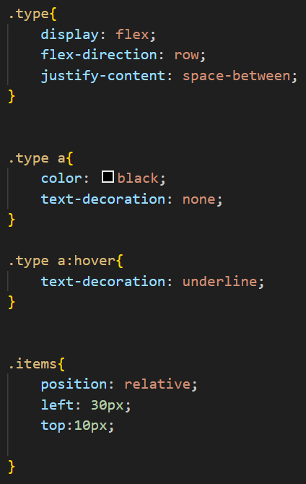
Header Design

Slide 16
Header Design

Slide 17
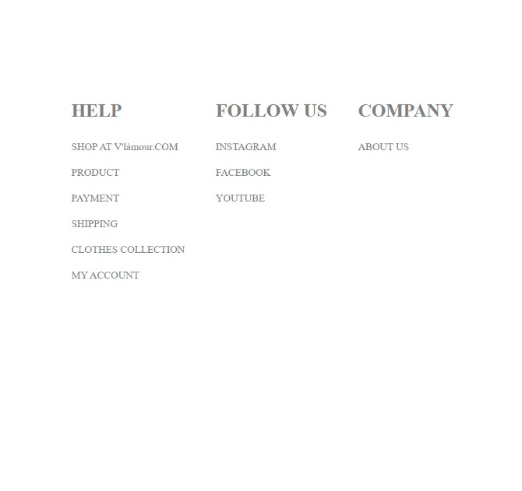
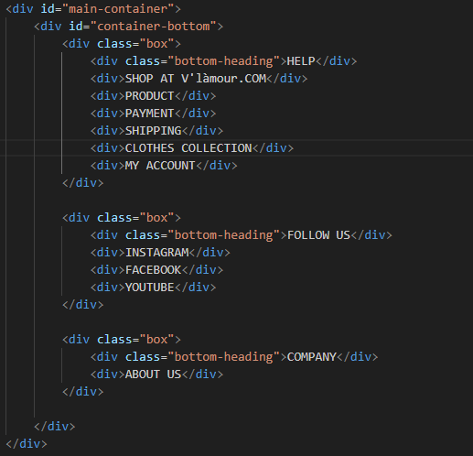
Footer Design

Slide 18
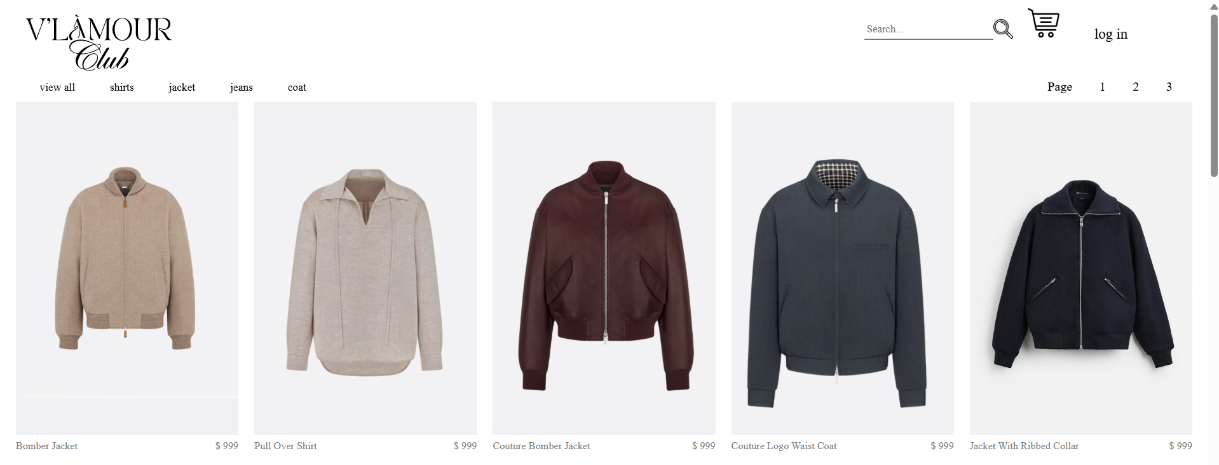
Mens Product Page:
How Js manages the display of the mens clothing products and enables search and filtering ??
Product Data Array
this code can be elaborated in 2 parts:
Displaying Items Function

Slide 19
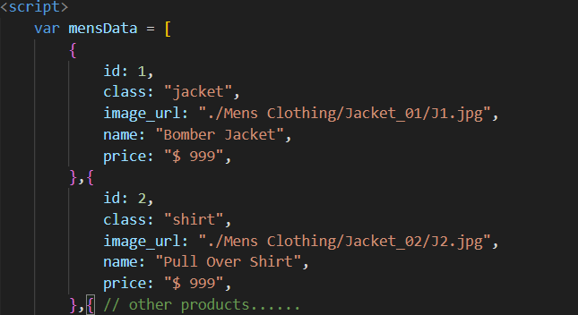
Product Data Array :
Array
Purpose:
The mensData array holds the information for each product available on the mens clothing page.
properties
Structure:
Each product is represented as an object with the following properties.
id: A unique identifier for each product.
class: The category of the product (e.g., jacket, shirt, coat), which is useful for filtering.
image_url: The path to the product's image, which will be displayed on the webpage.
Benefit: This structured data allows for easy retrieval and display of products, enabling features like search and filtering.

Slide 20
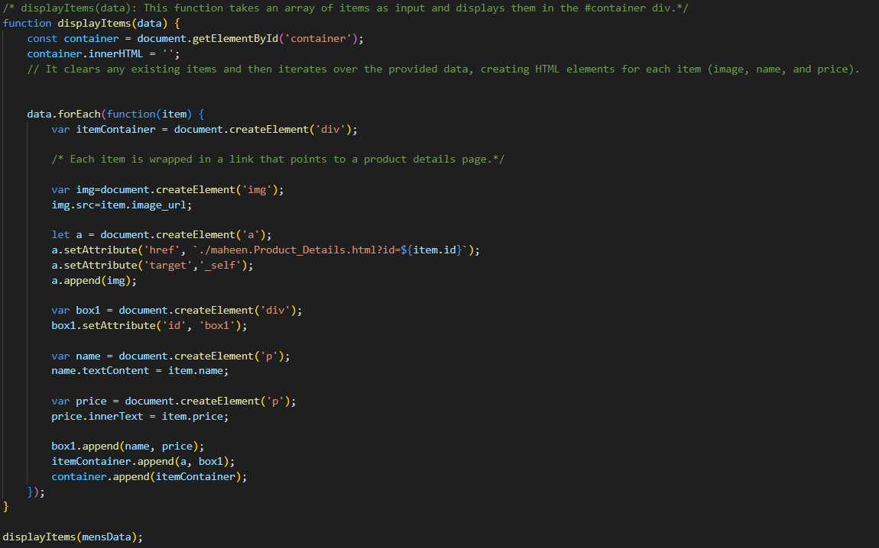
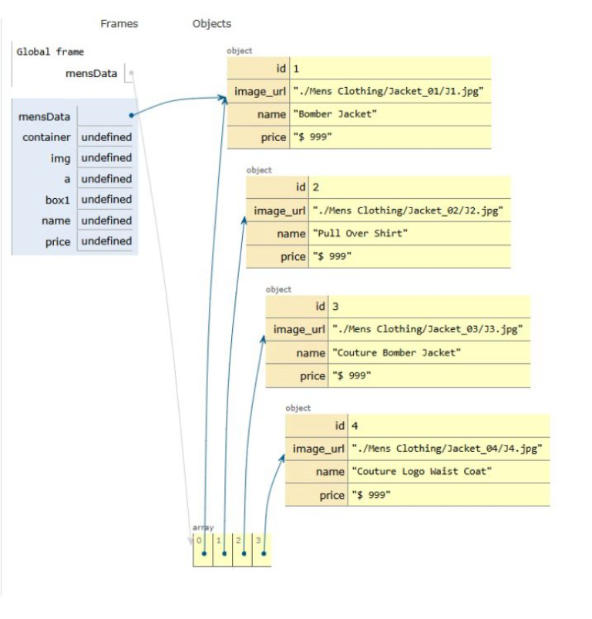
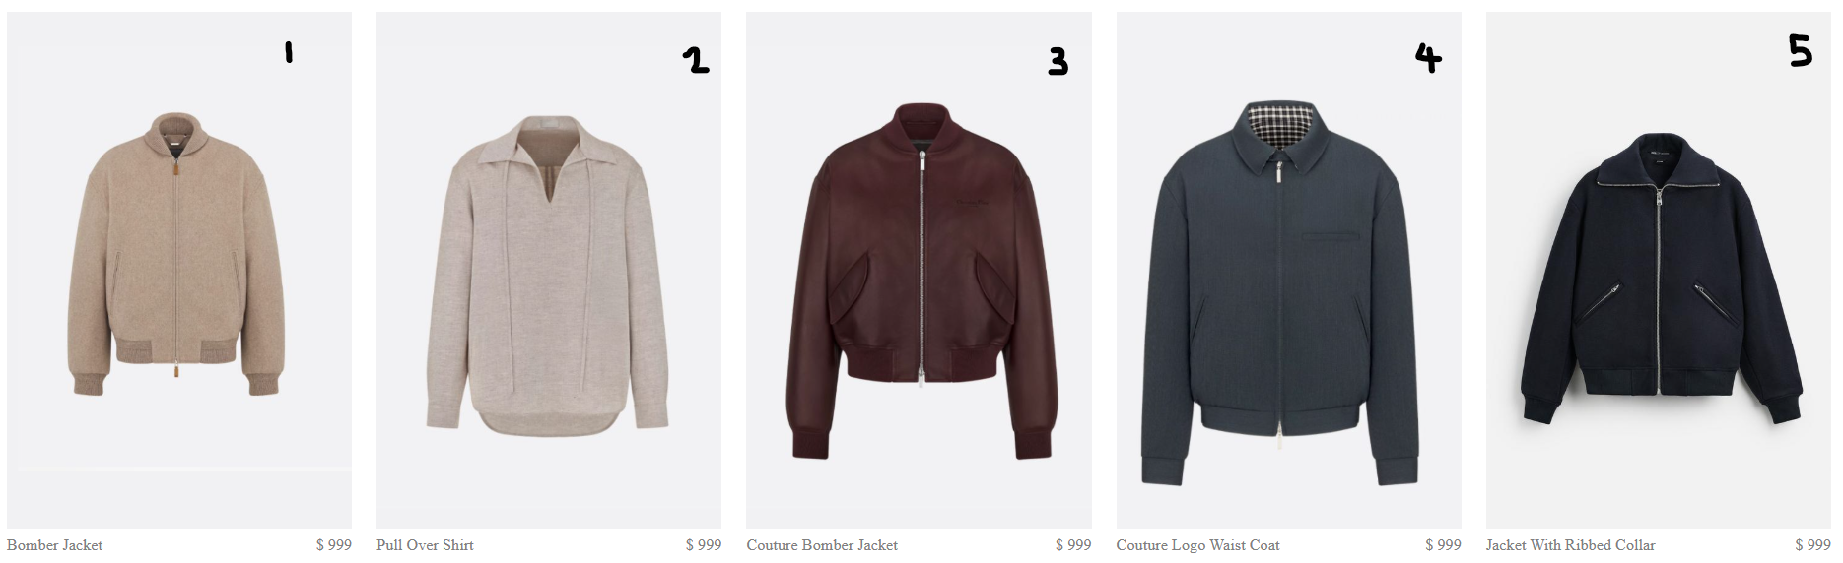
Clear Previous Items: The function starts by clearing any existing content in the container div to ensure only the current items are displayed.
Iterate Over Items: It uses forEach to loop through each product in the data array.
Create HTML Elements: For each product:
<div>
<img>
<a>
<div> (box1)
2. Displaying Items Functions :

Slide 21
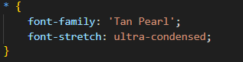
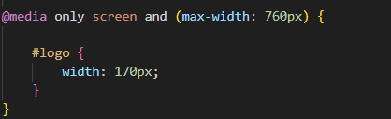
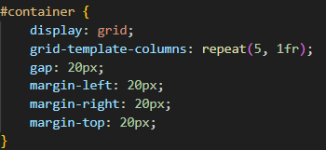
Mens Product Page (css):
Universal Selector (*)
Adjust the logo size for smaller screens, ensuring a responsive layout that adapts different devices.
uses CSS grid to arrange products in a responsive grid format.

Slide 22
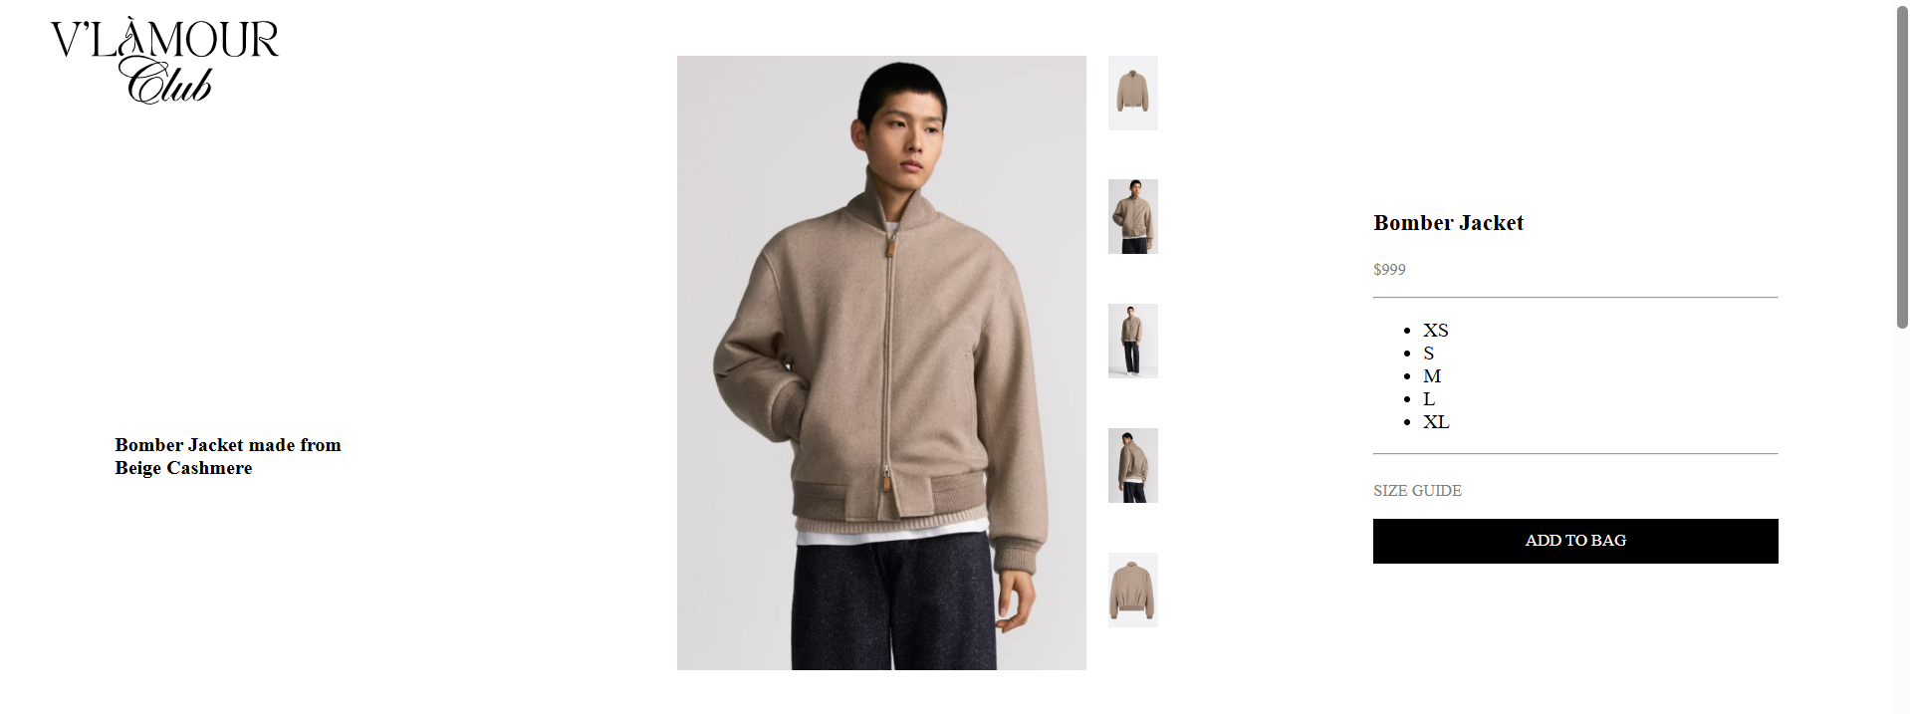
Product Detail Page:

Slide 23
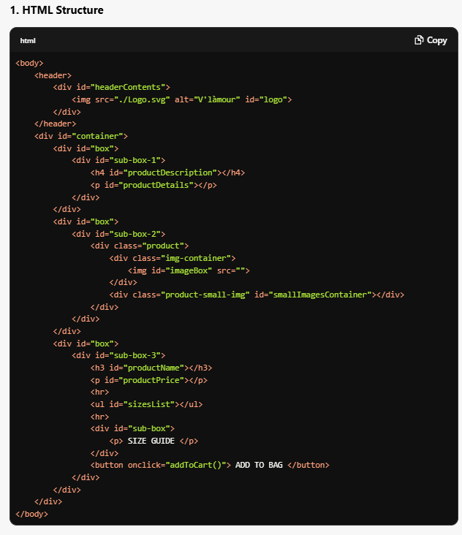
Product Detail Page (HTML) :
Header: Contains the logo of the website.
Container: Divided into three main sections:
Product Description: Displays the product's description.
Product Image: Displays the main product image along with smaller images for selection.
Product Details: Displays the product name, price, available sizes, and a button to add the item to the cart.
product description
Holds product image
name, price and size

Slide 24
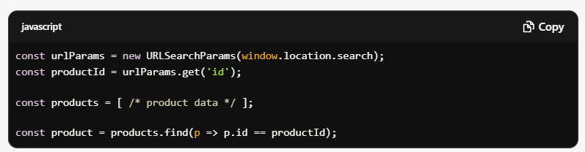
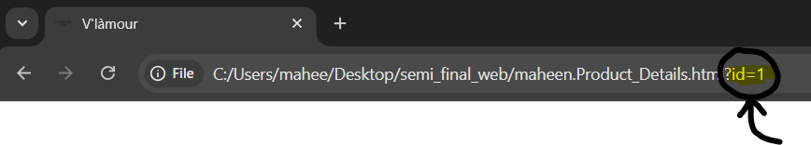
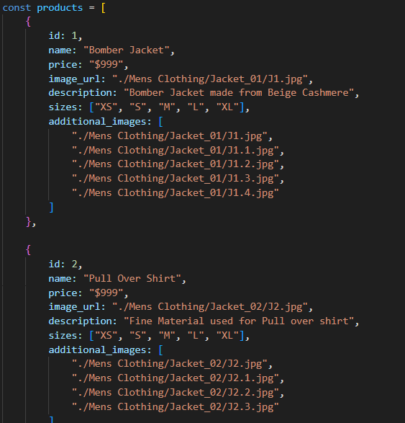
URL Parameters: Retrieves the product ID from the URL, which is passed when the product is clicked from the previous page.
Product Data: An array containing details about each product, including id, name, price, description, sizes, and additional images.
Finding the Product: Uses the find method to search for the product in the products array based on the productId.

Slide 25
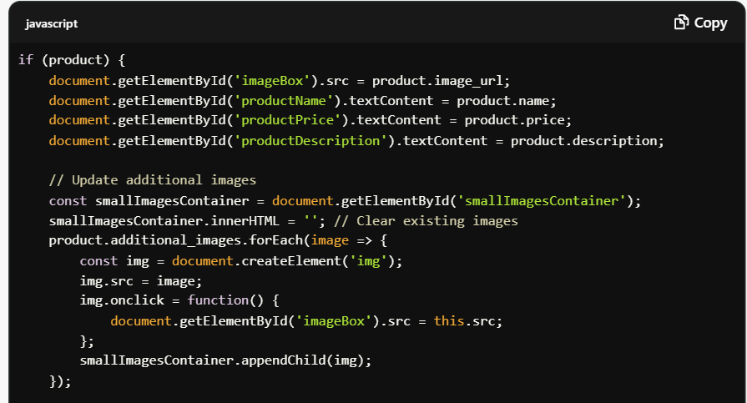
Dynamic Content Update: If the product is found:
Updates the main image, product name, price, and description in the HTML.
Populates additional images that can be clicked to change the main product image.
Fallback Handling: If no product is found, it displays a "Product not found" message.

Slide 26



Search & Filter
。

Slide 27
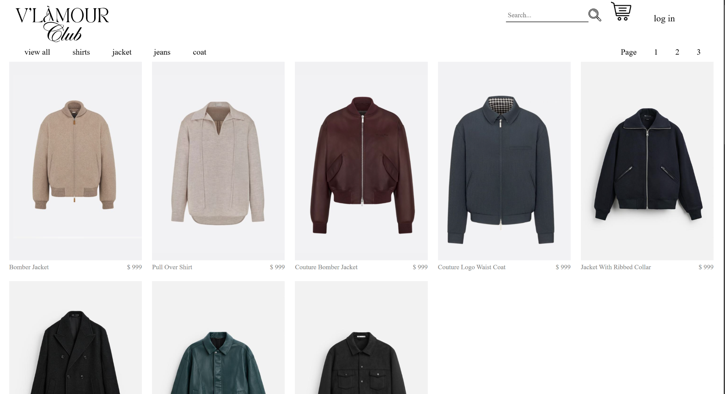
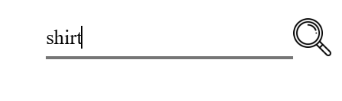
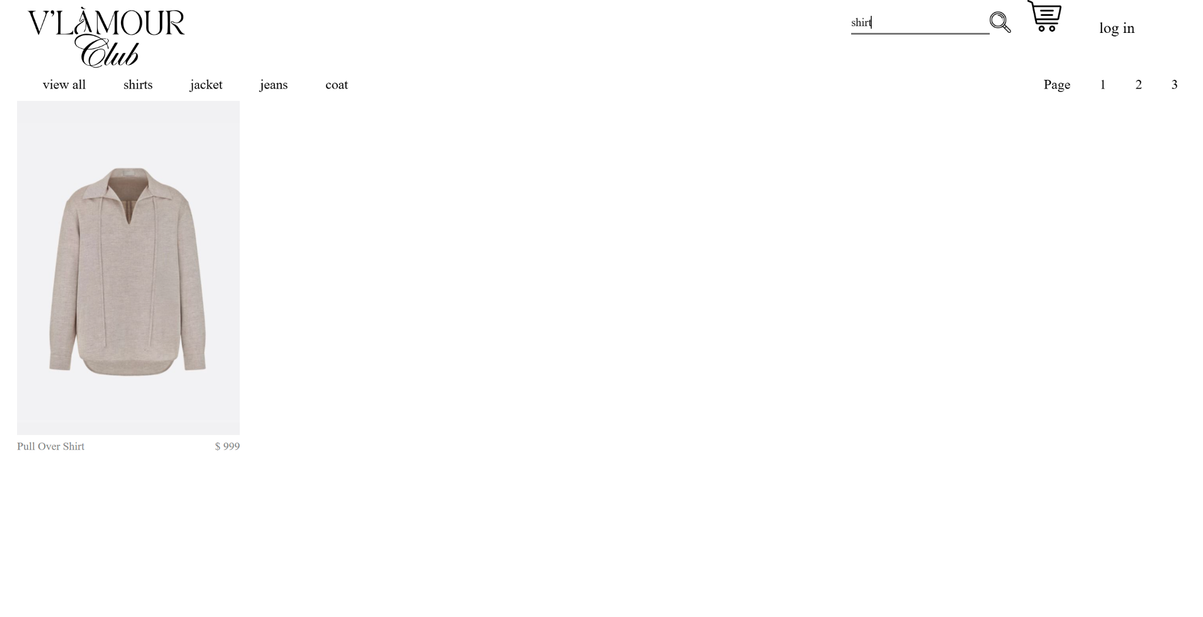
Search & Filter

Slide 28
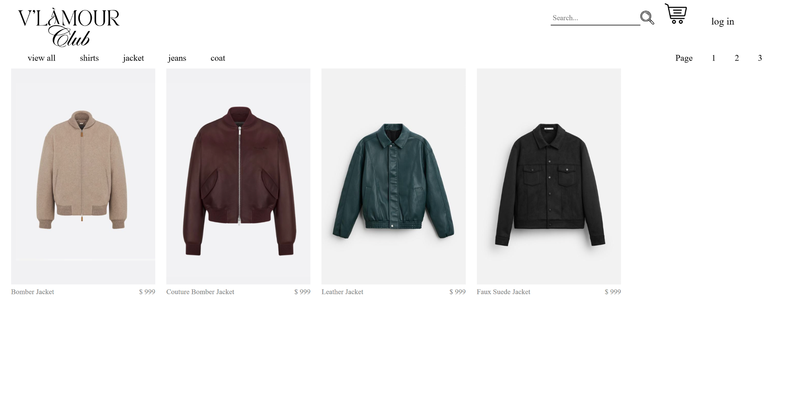
Search & Filter

Slide 29
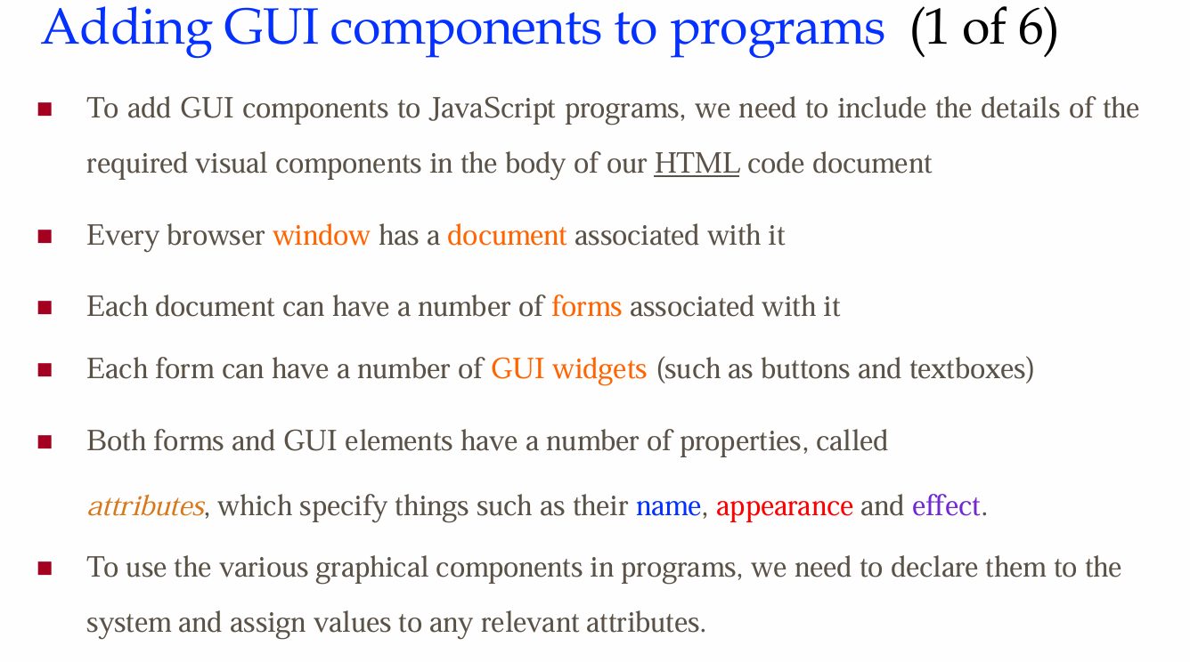
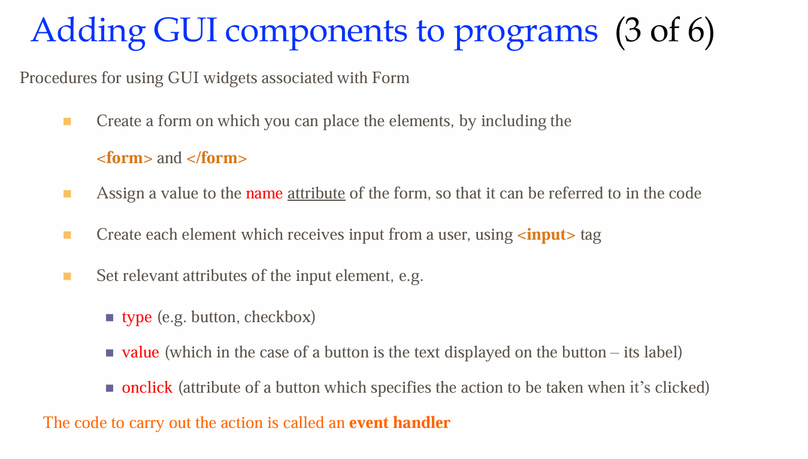
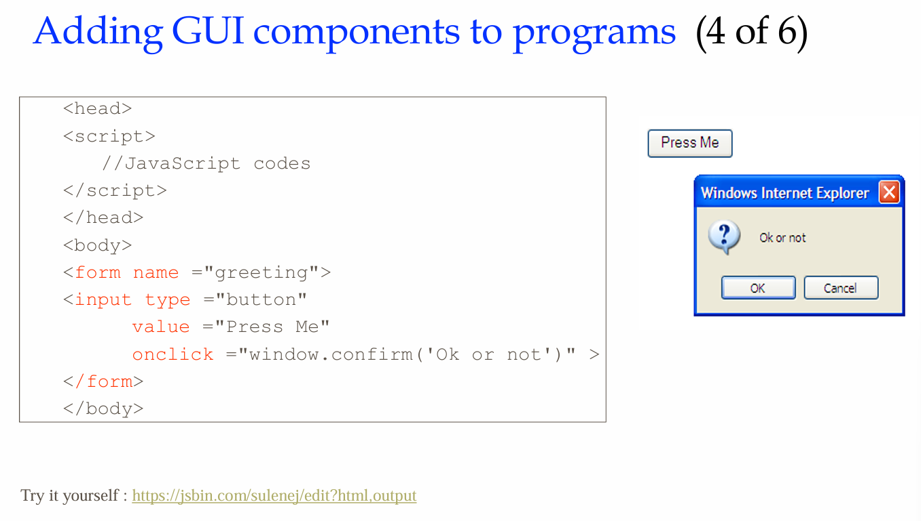
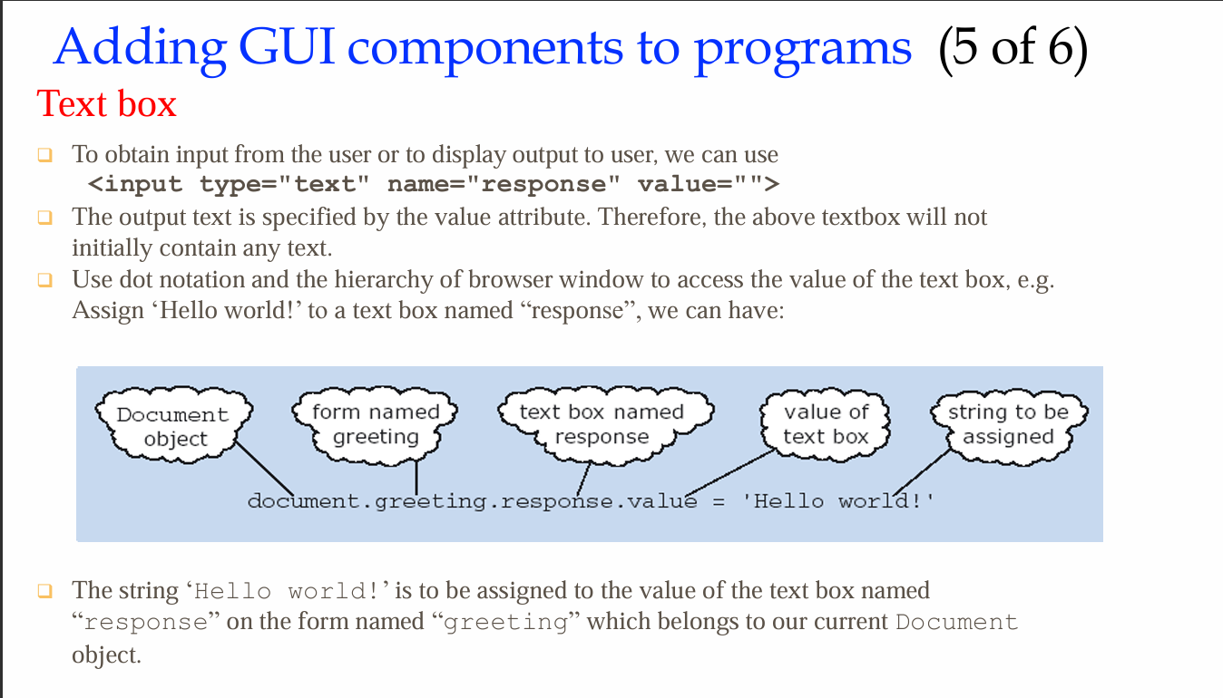
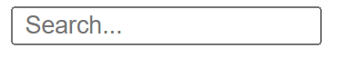
Search
lecture 4 & tut 5
<input>: To receive the input from the users , type: “text”
id: gives an element a unique name that can be used to identify it.
placeholder: display on the text box
onKeyup: when you type in the box and release a key, the list of items changes to match what you've typed.

Slide 30
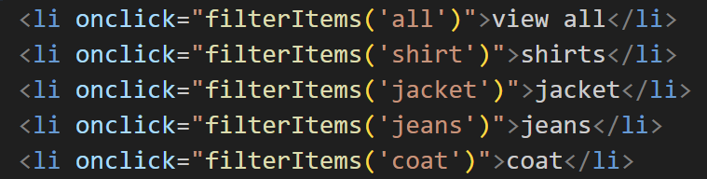
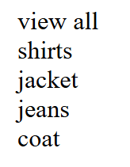
Filter
onClick: attribute of a button which specifies the action to be taken when it’s clicked

Slide 31
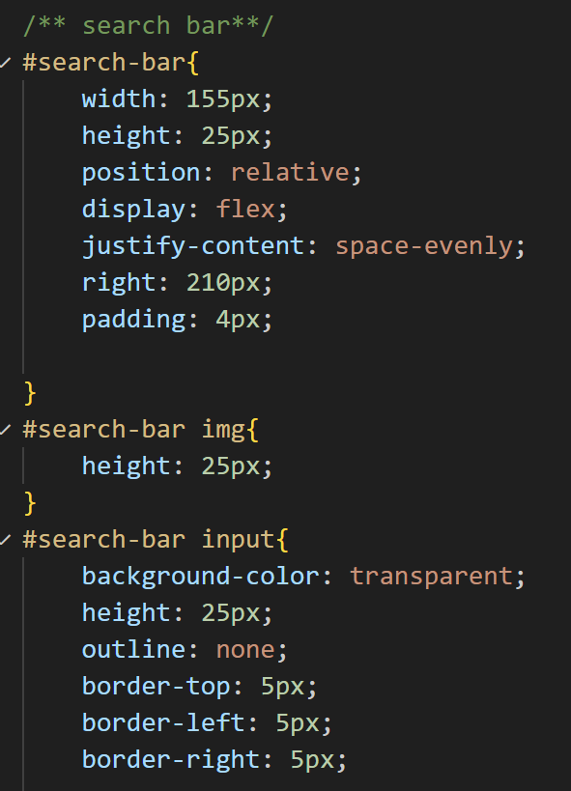
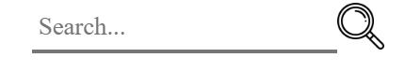
Search & Filter
css

Slide 32

Search & Filter
The list of the clothes
Class
id=”find”
name
filterItems()
getDisplay()

Slide 33

Search & Filter
The currentFilter variable keeps track of the currency selected category, initially set to ‘all’ to display all items by default
This function will update the display when the users types a relevant keys in search box
lecture:3 & tut:3 : function
tut:8: .getELementById()
The function retrieves the value from the search box using document.getElementById(‘find’) and converts it to lowercase for comparison.

Slide 34

Search & Filter
The function filters our dataset, mensData, which contains all our clothing items. It checks each item against two criteria: the selected category and the search input.
Checks if the Items belongs to the currently selected category( or if ‘all’ is selected)
Checks if the item’s name matches the search input
Both of the condition must be true for an item to be
Display the item called fileredData

Slide 35

Search & Filter
This function updates the currrentFilter variable based on the category selected by the user (e.g., “jacket”).
Updates the currentFliter
Refresh the display

Slide 36

Search & Filter
The getDisplay() :
Retrieves the search input, filters the items based on the current category and search input, and displays the filtered results.
The filterItems() :
Updates the category filter and refreshes the display to show items that match the new filter.

Slide 37




Search & Filter
Case 1:
Search: shirt
Filter: all
Case 2:
search:
Filter: Jacket
Case 3:
search: shirt
Filter: Jacket

Slide 38

LOGIN PAGE

Slide 39



Slide 40




Slide 41

addEventListener
DOMContentLoaded

Slide 42



Slide 43


SessionStorage

Slide 44


Slide 45

Add To Cart Page

Slide 46

Application:
ADD TO BAG - the product from product page is redirected to another page called
Add to Cart Page

Slide 47

The Add To Cart Page
In terms of user experience,
Allows for more ?
To encourage ?
A way to support ? through Add To Cart

Slide 48

Using the power of JavaScript:

Slide 49
Purpose of document.getElementById("addToCartButton").addEventListener("click", function() {
Purpose of const product = {
Purpose of localStorage.setItem("cart", JSON.stringify(product));
Purpose of window.location.href = "/checkout.html";
Upon clicking button, it helps submit forms, and to be able to obtain data from server to change the contents of Add to Cart page
To define collection of related data i.e. grouping id,name,price,category
Allows to store key-value and setItem() stores product data under “cart”
Since localStorage only stores strings, the product object is converted to a JSON string using JSON. stringify().
To navigate to a new URL, for the example /checkout.html is used

Slide 50


Your not alone bro
🥹

Slide 51

HTML
HTML ( Shell )
provides?
Tag <header> holds the V'làmour logo, loaded from an SVG file
id=“cartNavBar” shows ‘CART (1)’
id=“product-details” section displays the example of one of our products Bomber Jacket, with its reference number, size and price.
Providing an option to Change Quantity, Delete or Save For Later allows the user freedom to choose

Slide 52

CSS
CSS (Appearance)
to how does this affect you as user and customer?
#main-container?
#cartNavBar?
#cart-nav?

Slide 53

Q&A

